Slide 1
Set, Map and Hash table
University of Technology and Engineering
Vietnam National University Hanoi

Slide 2

Set
A set is a collection of elements which are not in any particular order
All elements of a set are different

Slide 3
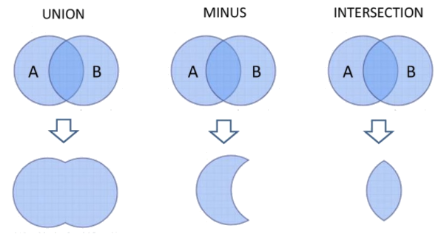
Set operations

Slide 4
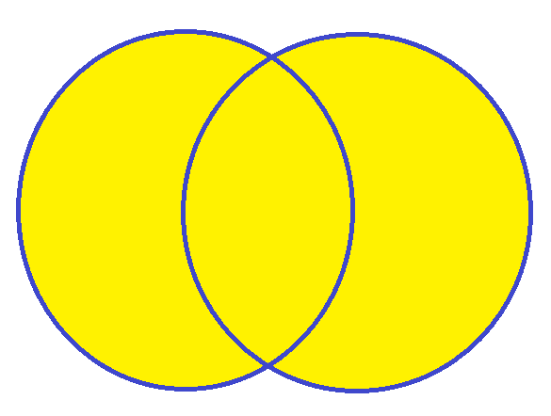
Set operations Union
Definition: Let A and B be sets, the union of two sets A and B is the set that contains all elements in A, B, or both.
Example:
A={0,1,3, 5,8}
B= {2,5,8,9}
A∪B = {0,1,2,3,5,8,9}
Note: A∪B = B∪A
1
8
2
0
5
9
3

Slide 5
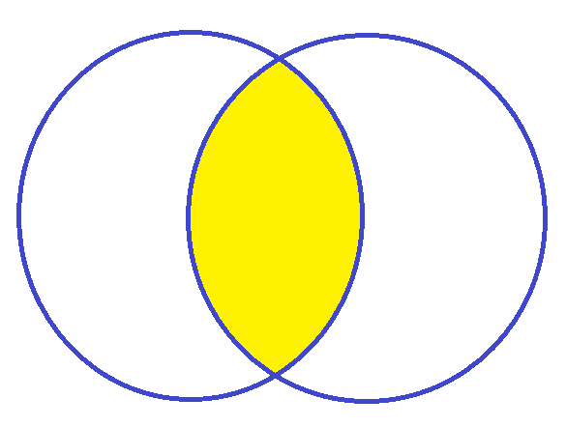
Set operations Intersection
Definition: Let A and B be sets, the intersection of two sets A and B is the set of elements that are in both A and B.
Example:
A={1,2, 3,4,5}
B= {1,3,9,12}
A ∩B = {1,3}
Note: A∩B = B∩A
2
1
9
4
3
12
5

Slide 6
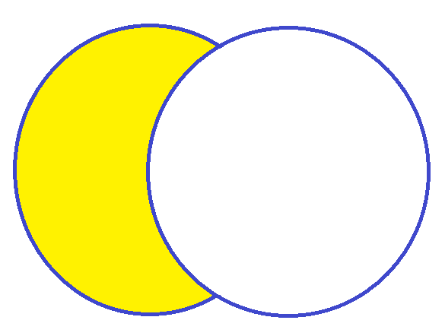
Set operations Minus
Definition: Let A and B be sets, the difference of A minus B (A – B) is the set of elements that are in A, but not in B.
Example:
A={1,2,3}
B= {2,3,4}
A - B = {1}
2
1
3
4

Slide 7
Using set library
Unordered sets are containers that store unique elements in no particular order
// unordered_set::insert #include <iostream> #include <string> #include <array> #include <unordered_set> int main () { std::unordered_set<std::string> myset = {"yellow","green","blue"}; std::array<std::string,2> myarray = {"black","white"}; std::string mystring = "red"; myset.insert (mystring); // copy insertion myset.insert (myarray.begin(), myarray.end()); // range insertion myset.insert ( {"purple","orange"} ); // initializer list insertion std::cout << "myset contains:"; for (const std::string& x: myset) std::cout << " " << x; std::cout << std::endl; return 0; }
Example: Insert elements to a set

Slide 8

Maps
A map models a searchable collection of key-value entries
Multiple entries with the same key are not allowed
Key | Value
0000001 | Le Sy Vinh
0000002 | Nguyen Van An
0000003 | Tran Quoc Hung

Slide 9
The map operations
get(k): if the map M has an entry with key k, return its associated value; else, return null
put(k, v): insert entry (k, v) into the map M; if key k is not already in M, then return null; else, return old value associated with k
remove(k): if the map M has an entry with key k, remove it from M and return its associated value; else, return null

Slide 10
Example
Operation Output Map
put(5,A) null (5,A)
put(7,B) null (5,A),(7,B)
put(2,C) null (5,A),(7,B),(2,C)
put(8,D) null (5,A),(7,B),(2,C),(8,D)
put(2,E) C (5,A),(7,B),(2,E),(8,D)
get(7) B (5,A),(7,B),(2,E),(8,D)
get(4) null (5,A),(7,B),(2,E),(8,D)
get(2) E (5,A),(7,B),(2,E),(8,D)
remove(5) A (7,B),(2,E),(8,D)
remove(2) E (7,B),(8,D)
get(2) null (7,B),(8,D)

Slide 11
A Simple List-Based Map
We can easily implement a map using a singly linked list
head
9
c
6
c
5
c
8
c
entries

Slide 12
The get(k) Algorithm
Algorithm get(k):
p = head;
while p is not null do
if p→element.key = k then
return p→element.value;
p = p→next;
return null {there is no entry with key equal to k};
Complexity?

Slide 13
The put(k,v) Algorithm
Algorithm put(k,v):
p = head;
while p is not null do
if p.element.key = k then
t = p→element.value;
p→element.value = v;
return t {return the old value};
p = p→next;
insertLast((k,v));
return null {there was no previous entry with key equal to k};
Complexity?

Slide 14
The remove(k) Algorithm
Algorithm remove(k):
p = head;
while p is not null do
if p.element.key = k then
t = p→element.value;
remove (p);
return t {return the old value};
p = p→next;
return null {there is no entry with key equal to k};
Complexity?

Slide 15
Performance of a List-Based Map
get(k): O(n)
put(k, v): O(n)
remove(k): O(n)
Need a data structure to implement map efficiently

Slide 16
Using map library
#include <iostream> #include <string> #include <map> int main (){ std::map<char,int> mymap; mymap['a']=10; mymap['b']=20; mymap['c']=30; mymap.at('a') = 15; mymap.at('b') = 50; std::map<char,int>::iterator it; for (it=mymap.begin(); it!=mymap.end(); ++it) std::cout << it->first << ": " << it->second << '\n'; return 0; }

Slide 17
Simple map
How to implement a simple map whose keys are integer numbers in range 0…1000?
Key | 0 | 1 | 2 | 500 | 1000
Value | A | B | B | G | F
0 | 1 | 2 |  |  | 500 |  |  |  | 1000
A | B | B |  |  | G |  |  |  | F
Using an array of 1001 elements to store a map

Slide 18
Complexity of simple map operations
get(k):
return M[k];
Complexity: O(1)
put(k, v):
old_value = M[k];
M[k] = v;
return old_value;
Complexity: O(1)
remove(k):
M[k] = Null;
Complexity: O(1)

Slide 19
Hash Tables

Slide 20

Hash Functions
A hash function h maps keys of a given type to integers in a fixed interval [0, N − 1]. The integer h(x) is called the hash value of key x
Example: h(x) = x mod N
Key | 0 | 3 | 1001 | 1002 | 1005
h(key) | 0 | 3 | 1 | 2 | 5
Value | A | B | B | G | F
h(key) = key mod 1000

Slide 21
Hash Tables
A hash table is used to store a map after hashing the keys
Example: Hashing keys by a hash function
Key | 0 | 3 | 1001 | 1002 | 1005
h(key) | 0 | 3 | 1 | 2 | 5
Value | A | B | B | G | F
Hash table
0 | 1 | 2 | 3 |  | 5 |  |  |  | 1000
A | B | G | B |  | F

Slide 22
Collision
The hash values of two keys might have the same value (collision) causing different elements are mapped to the same cell on the hash table.
Key | 0 | 3 | 1001 | 1003 | 1005
h(key) | 0 | 3 | 1 | 3 | 5
Value | A | B | B | G | F
h(key) = key mod 1000

Slide 23
Collision Handling
Separate Chaining: let each cell in the table point to a linked list of entries that map there
0
0,A
Key | 0 | 3 | 1001 | 1003 | 1005
h(key) | 0 | 3 | 1 | 3 | 5
Value | A | B | B | G | F
1
1001,B
2
3
3,B
1003,G
4
h(key) = key mod 1000
5
1005, F
Hash table

Slide 24
Linear probing collions
Example:
h(x) = x mod 13
Insert keys 18, 41, 22, 44, 59, 32, 31, 73
Open addressing: the colliding item is placed in a different cell of the table
Linear probing handles collisions by placing the colliding item in the next (circularly) available table cell
Each table cell inspected is referred to as a “probe”
Colliding items lump together, causing future collisions to cause a longer sequence of probes
0
1
2
3
4
5
6
7
8
9
10
11
12
41
18
44
59
32
22
31
73
0
1
2
3
4
5
6
7
8
9
10
11
12

Slide 25
Hash Functions
A hash function: h(key) = key mod N
The number N should be a prime number to avoid
as many collisions as possible.
Example:
{200, 205, 210, 215,.., 600}:
3 collisions with N=100
No collision with N=101

Slide 26
Applications
Digital signatures Message-authentication code (MAC) Password tables Key updating: key is hashed at specific intervals resulting in new key

Slide 27
Map operations with Separate Chaining used for Collisions
Let A[h(k)] be a linked list to store the map of all elements whose
hash values are h(k).
Algorithm get(k):
return A[h(k)].get(k);
Algorithm put(k,v):
return A[h(k)].put(k,v);
Algorithm remove(k):
return A[h(k)].remove(k);

Slide 28
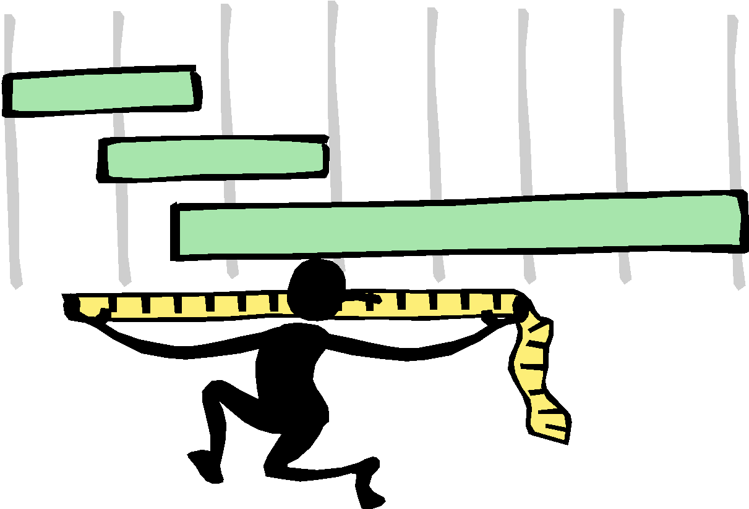
Performance and applications
In the worst case, searches, insertions and removals on a hash table take O(n) time
The load factor α = n/N affects the performance of a hash table
In practice, hashing is very fast provided the load factor is not close to 100%
The expected running time of map operations in a hash table is O(1)

Slide 29
Exercises
Given a list of students (id, name):
(1,A), (3,B), (10, C), (54, D) , (9, A)
Your task is to propose a hash function, and draw the hash table with the proposed hash function using both collision handling methods
Given a list of students (id, name):
(7,A), (3,B), (11, C), (4, D) , (8, G), (16, E), (21, B), (5, G)
Your task is to propose a hash function, and draw the hash table with the proposed hash function using both collision handling methods

